Slide 1
Atlanta Bike Share Analysis
General Assembly, GA: Data Science 101

Slide 2
Problem Statement
What is the likelihood that a Bike Share program will succeed in the City of Atlanta? http://atlantabicycleshare.com/
Which age range will rent and/or use Bike Share bikes the most in another metropolitan city?
Which age range(s) uses Bike Share bikes the most ?

Slide 3
Data, Collection Method and Pre-Processing
Data obtained from:
NYC: Citi Bike https://www.citibikenyc.com/system-data
Chicago: Divvy https://www.divvybikes.com/data
Boston: Hubway http://hubwaydatachallenge.org/trip-history-data/
Collection Method
Downloaded CSV files (Chicago Q1 & Q2 2015 Boston 2011 to 2013 NYC Jan 2015 to Jul 2015)
Loaded into Sql Server via Integration services. Conformed gender and date time of trip into common values
Aggregated transaction data to City, Gender, Age, Age Range, Number of records(number of rentals), and Total Duration (Seconds)

Slide 4
Data, Collection Method and Pre-Processing
Converted Age Ranges to Booleans
Converted Males to 1 and Females to 0
 | NumRec | Gender | Age | YearOfBirth | TotalDur_sec | AvgDur_sec | AgeRange_12-17 years old | AgeRange_18-24 years old | AgeRange_25-34 years old | AgeRange_35-44 years old | AgeRange_45-54 years old | AgeRange_55-64 years old | AgeRange_65-74 years old | AgeRange_75 Years or older
137 | 34519 | 0 | 25 | 1990 | 29501893 | 854 | 0 | 0 | 1 | 0 | 0 | 0 | 0 | 0
138 | 94877 | 1 | 25 | 1990 | 65453986 | 689 | 0 | 0 | 1 | 0 | 0 | 0 | 0 | 0
139 | 25785 | 0 | 24 | 1991 | 21327350 | 827 | 0 | 1 | 0 | 0 | 0 | 0 | 0 | 0
140 | 65651 | 1 | 24 | 1991 | 46607724 | 709 | 0 | 1 | 0 | 0 | 0 | 0 | 0 | 0
141 | 16902 | 0 | 23 | 1992 | 13438980 | 795 | 0 | 1 | 0 | 0 | 0 | 0 | 0 | 0
142 | 38182 | 1 | 23 | 1992 | 25325204 | 663 | 0 | 1 | 0 | 0 | 0 | 0 | 0 | 0
143 | 8767 | 0 | 22 | 1993 | 6872118 | 783 | 0 | 1 | 0 | 0 | 0 | 0 | 0 | 0
144 | 23663 | 1 | 22 | 1993 | 15012151 | 634 | 0 | 1 | 0 | 0 | 0 | 0 | 0 | 0
145 | 4951 | 0 | 21 | 1994 | 3585130 | 724 | 0 | 1 | 0 | 0 | 0 | 0 | 0 | 0
146 | 18975 | 1 | 21 | 1994 | 11403200 | 600 | 0 | 1 | 0 | 0 | 0 | 0 | 0 | 0
147 | 2922 | 0 | 20 | 1995 | 2821387 | 965 | 0 | 1 | 0 | 0 | 0 | 0 | 0 | 0
148 | 12723 | 1 | 20 | 1995 | 7903008 | 621 | 0 | 1 | 0 | 0 | 0 | 0 | 0 | 0
149 | 2158 | 0 | 19 | 1996 | 1767642 | 819 | 0 | 1 | 0 | 0 | 0 | 0 | 0 | 0
150 | 5527 | 1 | 19 | 1996 | 4164618 | 753 | 0 | 1 | 0 | 0 | 0 | 0 | 0 | 0
151 | 1108 | 0 | 18 | 1997 | 927714 | 837 | 0 | 1 | 0 | 0 | 0 | 0 | 0 | 0
152 | 4891 | 1 | 18 | 1997 | 3533782 | 722 | 0 | 1 | 0 | 0 | 0 | 0 | 0 | 0
153 | 893 | 0 | 17 | 1998 | 766614 | 858 | 1 | 0 | 0 | 0 | 0 | 0 | 0 | 0
154 | 3176 | 1 | 17 | 1998 | 2406134 | 757 | 1 | 0 | 0 | 0 | 0 | 0 | 0 | 0
155 | 30 | 0 | 16 | 1999 | 19152 | 638 | 1 | 0 | 0 | 0 | 0 | 0 | 0 | 0
156 | 808 | 1 | 16 | 1999 | 516434 | 639 | 1 | 0 | 0 | 0 | 0 | 0 | 0 | 0

Slide 5
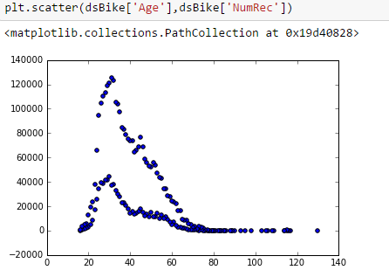
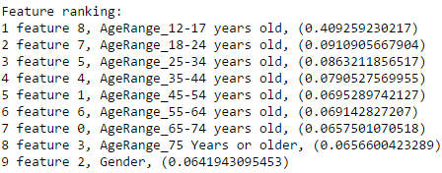
Modeling process and Results
Linear Regression
MSE: 421.37648
Logistic Regression
Accuracy Score: 0.025
Decision Tree
Training Score: 0.15
Test Score: 0
Feature Importance

Slide 6
Exploration and visualizations
Observed interesting patterns via Visualizations across 3 cities
Weekday vs. Weekend patterns
Rentals/Usage by Month
Rentals by gender
NYC explorations and visualizations
Location density for usage

Slide 7
Conclusion (Final thoughts…)
Challenges
Availability of open data to add more features
Successes
Patterns in NYC
Next Steps
Combine with weather data for dates/months
Combine with data

